Slide 1

Marketing Insights (with Fake Data)
SUSANA KOHLHAAS
IRONHACK
DECEMBER 2024
Notes:
Slide 1: Title Slide - "Marketing Insights (with Fake Data)"
"Good [morning/afternoon], everyone. Today, I’ll be sharing an exciting project that demonstrates how data-driven insights can help optimize marketing strategies. While the data I worked with is synthetic, it has been meticulously designed to mimic real-world marketing and sales scenarios. This allows us to test, analyze, and visualize insights as if we were working with real CRM data.
The goal of this project was to showcase a structured and scalable approach to understanding and analyzing marketing campaign performance. Using a combination of Python for analysis and Tableau for visualization, we’ve developed a robust workflow that could be easily adapted to real business data. By the end of this presentation, you’ll see how these techniques can be applied to improve campaign efficiency, allocate resources effectively, and ultimately maximize revenue."
Slide 2: Agenda
"Here’s a quick overview of what I’ll cover in this presentation:
We’ll begin with a Project Overview, where I’ll explain the objectives and focus of the project.
Next, we’ll look at the Dataset Overview, including how it was created and why it’s structured the way it is.
From there, I’ll walk you through the Exploratory Data Analysis (EDA) process, where we identified key patterns and trends in the data.
Moving on to Statistical Analysis, I’ll explain how we used inferential statistics to validate our findings.
We’ll then dive into Visualizations and Tableau, showcasing interactive dashboards that make the data easy to explore and understand.
Finally, I’ll wrap up with Conclusions and Next Steps, where I’ll share how this workflow can be applied to real-world marketing challenges and future enhancements.

Slide 2
Agenda
03
04
06
Proiect Overview
Dataset Overview
EDA
10
07
08
Conclusion
Next Steps
Statistical Analysis
Visualizations
Tableau
SUSANA KOHLHAAS
DECEMBER
2024
Notes:
Slide 1: Title Slide - "Marketing Insights (with Fake Data)"
"Good [morning/afternoon], everyone. Today, I’ll be sharing an exciting project that demonstrates how data-driven insights can help optimize marketing strategies. While the data I worked with is synthetic, it has been meticulously designed to mimic real-world marketing and sales scenarios. This allows us to test, analyze, and visualize insights as if we were working with real CRM data.
The goal of this project was to showcase a structured and scalable approach to understanding and analyzing marketing campaign performance. Using a combination of Python for analysis and Tableau for visualization, we’ve developed a robust workflow that could be easily adapted to real business data. By the end of this presentation, you’ll see how these techniques can be applied to improve campaign efficiency, allocate resources effectively, and ultimately maximize revenue."
Slide 2: Agenda
"Here’s a quick overview of what I’ll cover in this presentation:
We’ll begin with a Project Overview, where I’ll explain the objectives and focus of the project.
Next, we’ll look at the Dataset Overview, including how it was created and why it’s structured the way it is.
From there, I’ll walk you through the Exploratory Data Analysis (EDA) process, where we identified key patterns and trends in the data.
Moving on to Statistical Analysis, I’ll explain how we used inferential statistics to validate our findings.
We’ll then dive into Visualizations and Tableau, showcasing interactive dashboards that make the data easy to explore and understand.
Finally, I’ll wrap up with Conclusions and Next Steps, where I’ll share how this workflow can be applied to real-world marketing challenges and future enhancements.

Slide 3
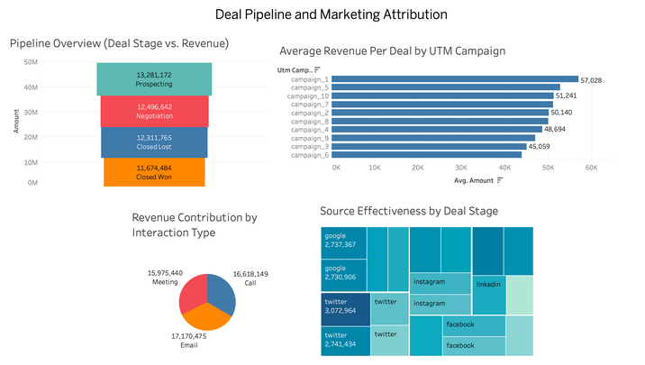
Proiect Overview
01
02
03
Objective
Key Business Questions
Deliverables
Create a Campaign Analysis Package to identify optimal combinations of utm_campaign, utm_source, and country for revenue maximization in "Closed Won" deals.
Which marketing campaigns drive the most revenue?
How do sources impact campaign performance?
Are there regional patterns in campaign success?
Insights for campaign optimization.
Tableau dashboards for interactive exploration.
Statistical validation of trends.
SUSANA KOHLHAAS
DECEMBER
2024
Notes:
Let me walk you through the Project Overview for our campaign analysis initiative. This slide outlines our objectives, the key business questions we aim to answer, and the deliverables that will result from this project."
Section 1: Objective
"First, our objective is to create a comprehensive Campaign Analysis Package. This will help us identify the optimal combinations of UTM campaign, UTM source, and country to maximize revenue in 'Closed Won' deals. In other words, we’re aiming to decode which campaign elements drive the highest revenue and how they perform across various regions."
Section 2: Key Business Questions
"Next, we’ve identified three key business questions that this analysis will address:
Which marketing campaigns drive the most revenue? This will help us prioritize efforts where they matter most.
How do sources, such as social media, email, or direct traffic, impact campaign performance? Understanding this will allow us to optimize resource allocation across channels.
Are there regional patterns in campaign success? This will help us identify geographical trends and tailor strategies accordingly."
Section 3: Deliverables
"Finally, the deliverables from this project are designed to provide actionable insights:
First, we’ll deliver insights for campaign optimization, enabling us to make data-driven decisions.
Second, we’ll create Tableau dashboards for interactive exploration, giving stakeholders a dynamic way to understand campaign performance.
And third, we’ll provide statistical validation of trends, ensuring that our recommendations are backed by solid data analysis."
Conclusion:
"In summary, this project will equip us with the tools and insights needed to maximize campaign effectiveness and revenue, ensuring a more strategic and data-driven approach to marketing. Thank you!"

Slide 4

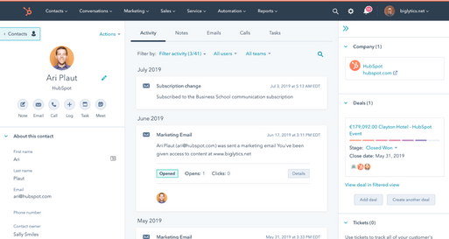
Dataset Overview
FAKER
CRM
CRM = Customer Relationship Management
FAKER
CRM
Data Generator
Customizable
Unique IDs
Campaign-level keywords, content, & interactions
Ensure data uniqueness and realism
Used Faker for country-specific fields
Maintime timelines (SendDate, CloseDate)
Contact Management
Sales Tracking
Marketing Automation
Analytics
SUSANA KOHLHAAS
DECEMBER
2024
Notes:
Introduction:
"Let’s dive into the dataset overview, where I’ll explain the two key components that form the foundation of our data: Faker and CRM systems. Together, they provide the framework for realistic and actionable insights in this analysis."
Section 1: Faker
"First, let’s discuss Faker. Faker is a powerful data generator tool that allows us to create customizable and realistic datasets. Here's how we used it:
It generates unique IDs, ensuring that every record is distinct and traceable.
We used it to define campaign-level details, such as keywords, content, and interaction logs. This level of granularity helps simulate real-world campaign performance.
Faker ensures data uniqueness and realism. For example, fields like email addresses, dates, and campaign names are not repeated and follow plausible patterns.
To add regional relevance, Faker was used to generate country-specific fields, which is critical for understanding how campaigns perform across geographies.
Finally, Faker helped us maintain realistic timelines by generating fields like SendDate and CloseDate, allowing us to analyze campaigns in a time-sensitive context.
By using Faker, we ensured that our synthetic dataset mirrors real-world scenarios while maintaining complete control over its structure."
Section 2: CRM
"Next, let’s talk about the CRM system, or Customer Relationship Management. This component forms the backbone of our analysis by capturing real-world business interactions. Key features of the CRM system include:
Contact Management: The CRM tracks customer information, ensuring we have a comprehensive view of individual and organizational contacts.
Sales Tracking: It records sales performance, which is essential for aligning campaign data with revenue outcomes.
Marketing Automation: CRM systems help track campaign interactions, such as email opens or ad clicks, providing behavioral insights.
Analytics: Most importantly, the CRM provides tools to analyze campaign performance, enabling us to evaluate key metrics and trends.
In essence, the CRM data provides a real-world perspective, while Faker fills in gaps with synthetic but realistic details to ensure the dataset is both robust and actionable."
Conclusion:
"In summary, the combination of Faker and CRM systems allowed us to construct a detailed and realistic dataset for campaign analysis. Faker provided customizable synthetic data to simulate real-world campaigns, while the CRM added context through real business interactions. Together, these tools ensure that our analysis is both accurate and scalable. Thank you."

Slide 5

Dataset Overview - Faker
Company Details
CompanyID: A globally unique identifier for each company, generated using uuid4.
CompanyName: The name of the company, generated using Faker.company.
Domain: The company's website domain, created using Faker.domain_name.
Contact Details
ContactID: A globally unique identifier for individual contacts, generated using uuid4.
LastName: The last name of the contact person, generated using Faker.last_name.
Email: The email address of the contact, generated using Faker.email.
Phone: The phone number of the contact, generated using Faker.phone_number.
Deal Information
DealID: A globally unique identifier for each deal, generated using uuid4.
DealName: A descriptive name for the deal, generated using Faker.bs.
Industry: The industry associated with the company or deal, generated using Faker.bs.
Address: The address associated with the company, generated using Faker.address.
Country: The country associated with the company, generated using Faker.country.
Stage: The current stage of the deal (e.g., Prospecting, Negotiation, Closed Won, Closed Lost), randomly selected.
Amount: The monetary value of the deal, randomly generated as a float between 1,000 and 100,000, rounded to two decimal places.
Source: The source of the deal, randomly selected from options like Referral, Website, and Cold Call.
Marketing and Interaction
SendDate: The date a marketing interaction was sent, generated using Faker.date_between within the last 4 years.
CloseDate: The date the deal was closed, calculated as a random number of days (10–7000) after the SendDate.
OpenStatus: A boolean indicating whether the marketing material was opened.
ClickStatus: A boolean indicating whether a link in the marketing material was clicked.
Type: The type of interaction (e.g., Email, Call, Meeting), randomly selected.
Outcome: The outcome of the interaction (e.g., Successful, Unsuccessful, Pending), randomly selected.
UTM Parameters (Marketing Analytics)
utm_source: The traffic source for marketing (e.g., Google, Facebook, LinkedIn).
utm_medium: The marketing medium used (e.g., CPC, Email, Social, Banner, Organic).
utm_campaign: The name of the marketing campaign (e.g., Search Ads, Retargeting, Influencer Campaign).
utm_term: A keyword identifier associated with the campaign (e.g., keyword_1 to keyword_30).
utm_content: Additional content-related metadata for the campaign (e.g., content_1 to content_30).
CRM DATA
1000 RECORDS
CAMPAIGN RELEVANT
DATA
266 RECORDS
utm_Campaign
utm_source
utm_medium
Country
Amount
CAMPAIGN LEARNINGS
SUSANA KOHLHAAS
DECEMBER
2024
Notes:
Let’s take a quick look at the dataset behind this analysis.
This is a fully synthetic dataset simulating real-world marketing and sales data. It includes 1,000 records focused on deals in the "Closed Won" stage, allowing us to analyze successful deals and revenue drivers. The data spans various marketing campaigns, traffic sources, regional information, and outcomes.
Key fields include utm_campaign, representing marketing efforts; utm_source, for traffic channels like Google or Facebook; utm_medium, indicating methods like CPC or email; and amount, the revenue generated from deals. Geographically, the dataset focuses on G7 countries plus Austria and Switzerland.
Additionally, the dataset features temporal fields, like SendDate and CloseDate, to simulate deal lifecycles, as well as campaign-level keywords, content, and interaction statuses.
To ensure quality, we addressed challenges like maintaining unique records, generating realistic country-specific data using the Faker library, and ensuring proper temporal relationships between SendDate and CloseDate.
This robust dataset forms the foundation for our analysis and insights."
Key Fields in the Dataset:
"The dataset is rich with fields that are crucial for our analysis:
UTM Parameters:
utm_campaign: Represents specific marketing efforts, such as seasonal promotions or product launches.
utm_source: Tracks traffic channels, like Google, Facebook, or LinkedIn, to understand where website visitors originated.
utm_medium: Indicates the method or type of traffic, such as CPC (cost-per-click), email campaigns, or organic search.
These parameters are critical for tracing the performance of marketing activities and attributing revenue accurately.
Amount: Captures the revenue generated from deals, which is our primary measure for campaign success.
Geography: The dataset focuses on G7 countries plus Austria and Switzerland, enabling a regional analysis of campaign performance.
Temporal Fields:
SendDate and CloseDate: These simulate the lifecycle of deals, helping us understand the duration of marketing-to-sale conversions.
Campaign-Level Keywords and Content: This includes specific messaging and content attributes that contribute to campaign performance.
These fields collectively give us a comprehensive view of marketing impact."
Understanding Deal Stages:
"The dataset also reflects deal stages, which are common in sales pipelines and critical for performance tracking:
Prospecting: The initial stage where leads are identified but not yet engaged.
Qualification: Leads are evaluated for their likelihood to convert into customers.
Proposal/Negotiation: Discussions and offers are made to finalize the deal.
Closed Won: Deals that successfully result in revenue.
Closed Lost: Deals that do not materialize, often due to budget, timing, or competition.
For this analysis, we’ve focused on 'Closed Won' deals, as they directly contribute to revenue and provide actionable insights into successful marketing efforts."

Slide 6
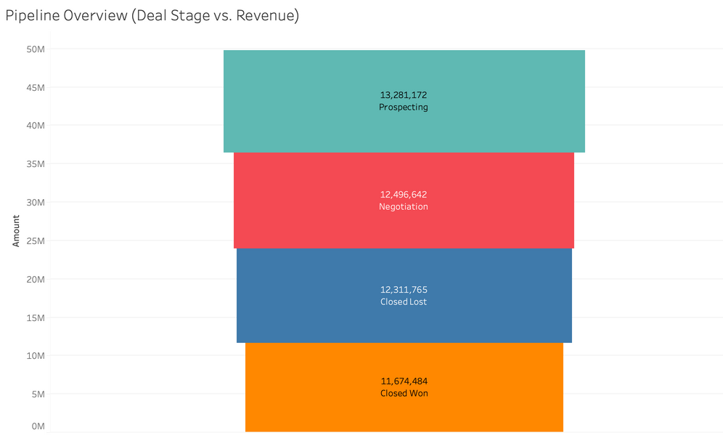
EDA
Let me walk you through why EDA was important, the insights it provided, and how it shaped the creation of the Tableau dashboard.
Why Conduct EDA
Validate data quality and detect anomalies.
Explore patterns in revenue, campaigns, and regions.
Identify key relationships for deeper analysis.
From EDA to Tableau
EDA insights shaped dashboard design.
Key trends transformed into interactive visuals.
Filters added for dynamic exploration of UTM parameters, regions, and stages.
SUSANA KOHLHAAS
DECEMBER
2024
Notes:
Introduction:
"Exploratory Data Analysis, or EDA, was a crucial step in understanding and preparing the dataset for deeper analysis and visualization. Let me walk you through why EDA was important, the insights it provided, and how it shaped the creation of the Tableau dashboard."
Why Conduct EDA:
"The goal of EDA was to uncover patterns, detect anomalies, and understand the structure of the data. Given the variety of fields—ranging from numerical values like revenue to categorical fields like UTM parameters and deal stages—EDA allowed us to:
Validate the data: Ensuring that the synthetic dataset generated with Faker and CRM integrations was free of missing or duplicate records.
Identify distributions: Understanding the spread of key variables, such as the distribution of revenue ('Amount') across different campaigns and regions.
Explore relationships: Detecting potential associations between variables, like how UTM source or medium correlates with revenue.
Spot anomalies: Identifying any unrealistic or outlier values, such as extreme revenue figures or invalid temporal relationships between SendDate and CloseDate."
Key Insights from EDA:
"Through EDA, we uncovered several important insights:
Revenue Trends: The majority of revenue is concentrated in a few campaigns and traffic sources, which led us to prioritize analyzing high-performing campaigns like Campaigns 1 and 5.
Geographical Patterns: G7 countries were dominant contributors, with noticeable regional variations in campaign success. This informed the regional breakdown in the Tableau dashboard.
Temporal Insights: The average deal lifecycle, calculated as the difference between SendDate and CloseDate, showed meaningful variations across campaigns and traffic sources.
Low Variability in Traffic Sources: While UTM sources like Google and Facebook performed similarly, specific mediums like CPC tended to generate higher revenue.
These insights provided the foundation for targeted hypothesis testing, such as the Chi-Square and Kruskal-Wallis tests."
From EDA to Tableau:
"EDA wasn’t just about insights; it also informed the design and focus of our Tableau dashboards. Here’s how:
Key Variables: Based on EDA, we prioritized fields like UTM parameters, revenue, geography, and deal lifecycle in our visualizations.
Anomaly Handling: Anomalies identified during EDA were either corrected or excluded to ensure accurate visualizations.
Interactive Design: To explore the regional and campaign-level trends uncovered in EDA, the Tableau dashboard includes filters for UTM parameters, regions, and deal stages.
Dynamic Revenue Tracking: Revenue patterns, identified during EDA, were transformed into intuitive visualizations, like bar charts for campaign comparisons and line charts for temporal trends."
Conclusion:
"In summary, EDA played a critical role in preparing the dataset, revealing insights, and structuring the Tableau dashboards. By first understanding the data at a granular level, we were able to create a dashboard that is not only interactive but also actionable for driving strategic decisions."

Slide 7

Tableau
SUSANA KOHLHAAS
DECEMBER
2024

Slide 8
Statistical Analysis
Analyze the association between UTM sources and revenue, using Chi-Square Test, Cramér's V, and Kruskal-Wallis Test
01
02
03
Hypothesis Testing: t-test
Cramér's V Measure:
Kruskal-Wallis Test:
Objective:
To determine if there is a significant association between UTM sources (categorical) and revenue categories (Low/High).
Conclusion: No significant association between UTM source and revenue categories.
Objective:
To measure the strength of the association between UTM sources and revenue categories using the Chi-Square test results.
Interpretation: Very low association
Objective:
To compare the revenue distributions (numerical) between campaigns 1 and 5 and determine if there is a significant difference
Conclusion: No significant difference
SUSANA KOHLHAAS
DECEMBER
2024
Notes:
’ll be presenting the statistical analysis of the relationship between UTM sources and revenue. Our objective was to determine whether different marketing sources significantly influence whether revenue is categorized as high or low."
Slide 2: Chi-Square Test
"To analyze this, we divided the revenue, a numerical field, into two categories: 'High' and 'Low,' based on quantiles. Since UTM source is a categorical variable, the Chi-Square test was an appropriate choice. This test examines whether there’s a significant association between two categorical variables—in this case, UTM source and revenue category.
The test yielded a Chi-Square statistic of 0.3242 and a p-value of 0.9882, indicating no significant association. Simply put, the choice of UTM source does not appear to influence whether revenue is high or low."
Slide 3: Cramér's V
"We also calculated Cramér's V, a measure of association for categorical variables, to quantify the strength of the relationship. The value was 0.0379, which is very close to zero, confirming a negligible association between UTM source and revenue categories."
Slide 4: Kruskal-Wallis Test
"Next, we used the Kruskal-Wallis test to compare revenue distributions across two campaigns, as revenue is a numerical variable. Unlike the Chi-Square test, Kruskal-Wallis is designed to compare distributions of a continuous variable across multiple groups—in this case, campaigns 1 and 5. The results showed no significant difference in revenue distributions between the two campaigns, indicating they performed similarly."
Slide 5: Conclusion
"In summary, the tests were chosen based on the nature of the data: categorical for UTM source and revenue categories, and numerical for revenue itself. The results show no significant association between UTM sources and revenue categories, nor significant differences between the revenue distributions of campaigns 1 and 5. This suggests that marketing sources and campaigns performed similarly in driving revenue."

Slide 9
Conclusion
Next Step
this project demonstrates how data-driven insights can empower marketing teams to make informed decisions. By analyzing campaign performance, traffic sources, and regional trends, it provides a clear roadmap for optimizing marketing strategies.
01
02
03
Leverage the Workflow with Real CRM Data
Monitor and Adjust in Real-Time
Incorporate Predictive Insights
Integrate Tableau dashboards into your workflow to provide real-time updates on campaign performance, ensuring timely adjustments.
Use predictive models to forecast campaign outcomes, helping you allocate resources strategically and plan future campaigns more effectively
Replace the synthetic data with real marketing campaign data to identify the highest-performing campaigns and channels in your organization.
SUSANA KOHLHAAS
DECEMBER
2024
Notes:
troduction:
"To wrap up, let’s talk about the key takeaways from this project and the next steps to turn these insights into practical actions for marketing teams."
Point 1: Leverage the Workflow with Real CRM Data
"First, the workflow demonstrated here can be directly adapted to your organization’s CRM data. By replacing the synthetic dataset with real marketing campaign data, you can identify the highest-performing campaigns and traffic sources. This enables a clear understanding of what drives the most revenue and allows you to focus efforts on the strategies that deliver the highest ROI."
Point 2: Monitor and Adjust in Real-Time
"Second, integrating Tableau dashboards into your workflow provides a real-time view of campaign performance. The interactive dashboards allow you to track key metrics, such as revenue by campaign or region, and quickly identify areas that need improvement. By continuously monitoring results, marketing teams can make timely adjustments and maximize campaign impact."
Point 3: Incorporate Predictive Insights
"Finally, predictive models take your analysis a step further by forecasting campaign outcomes. By identifying trends and patterns in historical data, you can predict future performance and allocate resources more strategically. For example, you might identify which campaigns are likely to succeed in specific regions or forecast which traffic sources will drive the most revenue next quarter. This forward-looking approach helps you plan campaigns more effectively and ensures marketing budgets are spent wisely."
Conclusion:
"In summary, this project provides a structured approach to understanding and optimizing campaign performance. By leveraging real data, monitoring trends dynamically, and incorporating predictive insights, marketing teams can make smarter, data-driven decisions that drive revenue and growth."

Slide 10
Thank You.
DECEMBER 2024
SUSANA KOHLHAAS

